Slide 1
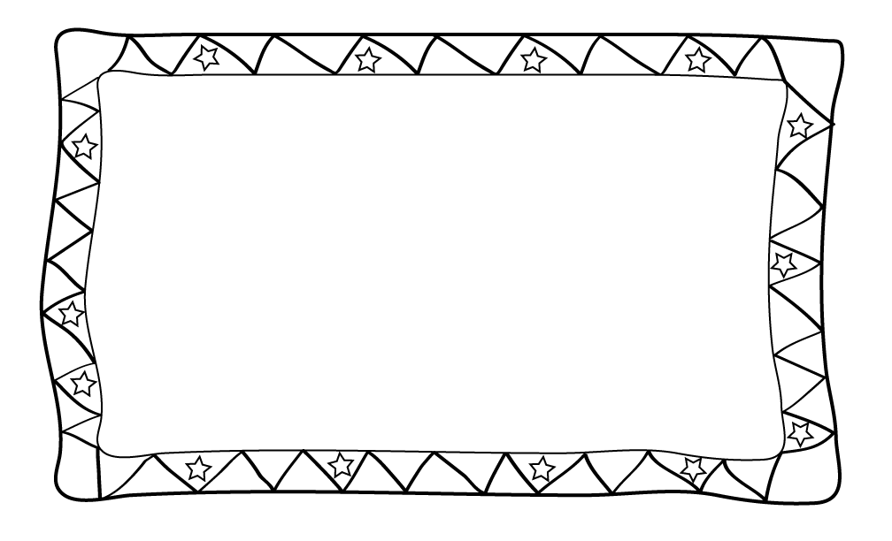
Flip Book
Transformation Project
Rotation
Translation
Reflection
Dilation
Notes:
http://www.graphicdesignbasics.com/2010/graphic-design-spotlight-animation-and-animators-part-i.html

Slide 2
FLIP BOOK PROJECT DUE: Friday, September 8th
Flip books are something that dates back many years ago. Modern day animation is based on the flip book concept. A flip book is essentially a book that has still frames on each page. As you flip the pages of the book, the image moves. We will be creating a book on Google Slides to help us learn about transformations.
Flip Book Instructions:
Create Cover Page with including your names.
Obtain graph template from my website.
When you are ready to move to the next slide, right click current slide and select duplicate.
Requirements:
Cover page
Narrative or storyline
Image/scene to make your narrative come to life!
Make your image move. Choose a row or column from movement chart (next slide). However, one additional movement must be a dilation
Choose a starting point on your image and track the movement of it using algebraic notation
You must have a minimum of 10 slides
Notes:
15 slides/ group.. 5 rows/ columns in chart.. 3 people per group…each person does one of each transformation in selected row/column.

Slide 3
Movement Chart
Your image must move in at least 4 ways. To decide how your image is going to move, choose a row or column from the chart below. CIRCLE IT. Your movements will be those that you circled.
Rotation (180 degrees about the origin) | Reflection Over x axis | Translation | Reflection over y axis
Reflection Over x Axis | Translation | Rotation (180 degrees about the origin) | Translation
Translation | Rotation (180 degrees about the origin) | Rotation (90 degrees about the origin) | Reflection Over y axis
Reflection Over y axis | Translation | Translation | Reflection Over x axis
Notes:
*change up that table so that every row/column/ diagonal has at least two isometries and one dilation?
*Make the table bigger so that it has more requirements?
*provide a minimum slide requirement?
*provide a suggestion for how many moving parts they must have in their flipbook?

Slide 4
Description of Movements
Here is an example of a chart to record the algebraic notation of your movements
 | Explain Location | Original Point | New Point | Actual Notation | Type of Transformation/Description
Slide 1-2 | Tip of nose | (9, 3) | (10, 1) | (x, y) → (x + 1, y + 2) | Translation: right 1, up 2
Slide 2-3 | Tip of nose | (10, 1) | (-10, 1) | (-x, y) | Reflection over y axis
Slide 3-4 | Tip of nose
Slide 4-5
Slide 5-6
…etc…

Slide 5
Pacing for Project
Friday 9/1 | Complete Rough draft of story to be turned. Create Google Slides and Share with partner and me! Create Cover Page (not included in slide count).
Tuesday 9/5 | Create two slides including their algebraic notation.
Wednesday 9/6 | Create two additional including their algebraic notation. [4/10 slides should be completed.]
Thursday 9/7 | Create two additional including their algebraic notation. [6/10 slides should be completed.]
Friday 9/8 | Create last four slides including algebraic notation. [10/10 slides should be completed!] Complete Partner Review. [Google Form found on website!] Complete Narrative Prepare for Presentations
Monday 9/11 | Presentation Day!

Slide 6
Rubric
Category | Description | Points Earned | Possible Points
Creativity/Originality | Contains a completed narrative that is at least 5 sentences long. The slides are colorful, related and representative of the narrative. |  | 10
Movements | The four chosen movements are accurately represented on the slides. At least one dilation is accurately used. |  | 18
Description of Movements | Contains accurate algebraic notations for each slide (i.e. you should have at least 9 algebraic notation descriptions) |  | 54
Student Role | Student contributed to project equally and completed assigned role. |  | 15
Presentation | Showcased Project. |  | 3
 | Total | _____/100

Slide 7
Student Roles
For this project you will be working with an assigned partner. Work with your partner to decide who will take each role.
The Narrator: Responsible for typing your storyline and completing 5 slides.
The Organizer: Responsible for contacting teacher for questions, sharing documents, and completing 5 slides.

Slide 8
Groups

Slide 9
Student Example

Slide 35
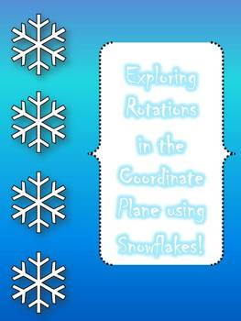
Credits & Terms of use
Thank You
Thank you again for showing interest in my work! Please let me know what you like and what I can do to improve this resource. Remember, if you leave feedback at my store you can earn credits towards future purchases! This download is a single use license and provides you with personal and single classroom use of this product. If you choose to blog/Facebook/pin about using this product, I would love to see it! Feel free to tag me or link back to the product. All pages of this document are copyrighted.
Let’s Connect
Blog
email: stefbub1@gmail.com
You Might Also Like
Credits Background: 3am Teacher, Fonts: www.dafont.com, FunFonts

